Slide 1
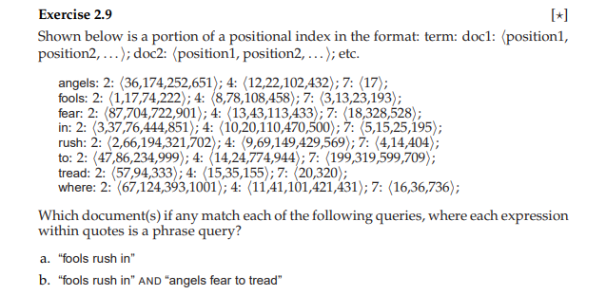

Slide 2
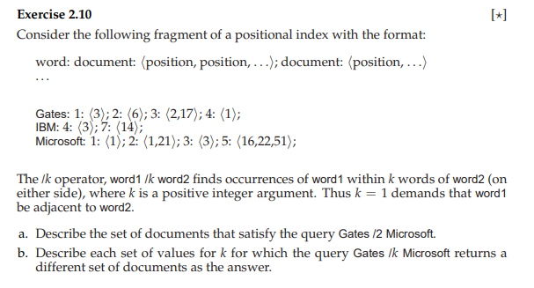

Slide 3
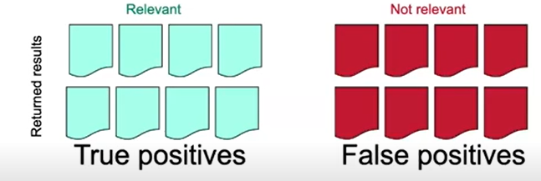
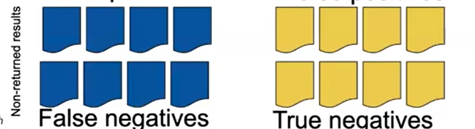
Result Assessment

Slide 4
Precision and Recall
Precision= relevant returned(true positive)/ total returned
Recall= true positive(returned relevant )/total relevant
Type I error (false positive)= quantified in precision
Type II error (false negative)= quantified in recall
Getting high precision and high recall

Slide 5
Dictionaries and Tolerant Retrieval

Slide 6
Standard Inverted Index
Stop words
Equivalence class : to-day=today, U.S.A
Porter Stemmer : feudalism= Feudal

Slide 7
Better than Binary search
Hash table : come from cryptography
Limitation of Hash function : Cashing locality , Duplicates , no range query , it requires enumerate and then look up separately
Binary Search Tree:
Oath, can, be, port, to, or, not

Slide 8
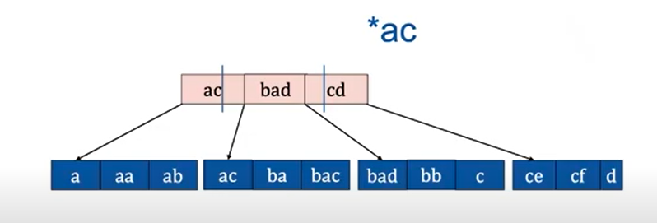
B and B+ Tree

Slide 9
Wild Card
Why to use wild cards:
the user is uncertain of the spelling of a query term( Sidney, Sydney)
the user is aware of multiple variants of spelling a term(colour, color)
the user seeks documents containing variants of a term that would be caught by stemming, but is unsure whether the search engine performs stemming (judicial vs judiciary )
A query such as mon* is known as a trailing wildcard query, because the * symbol occurs only once, at the end of the search string.
*Mon is leading wildcard query
How to solve se*mon?

Slide 10
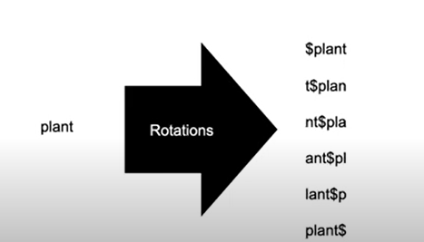
General Wild Card Queries
Permuterm Index
K-gram
Working:
Make wildcard query a Boolean query

Slide 11
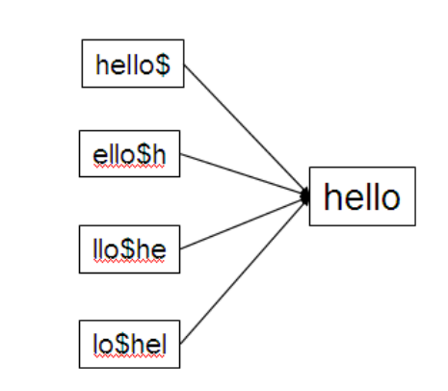
Permuterm Index
Use $ symbol into character set of term to mark the end of term .
Example : hello= hello$
Generate permuterm index by various rotation: creating permuterm vocabulary
M*n= (m*n$= n$m*)rotated wildcad
Fi*mo*er ?
Exhaustive enumeration for center string
Disadvantage ?
# of terms in other langauges

Slide 12
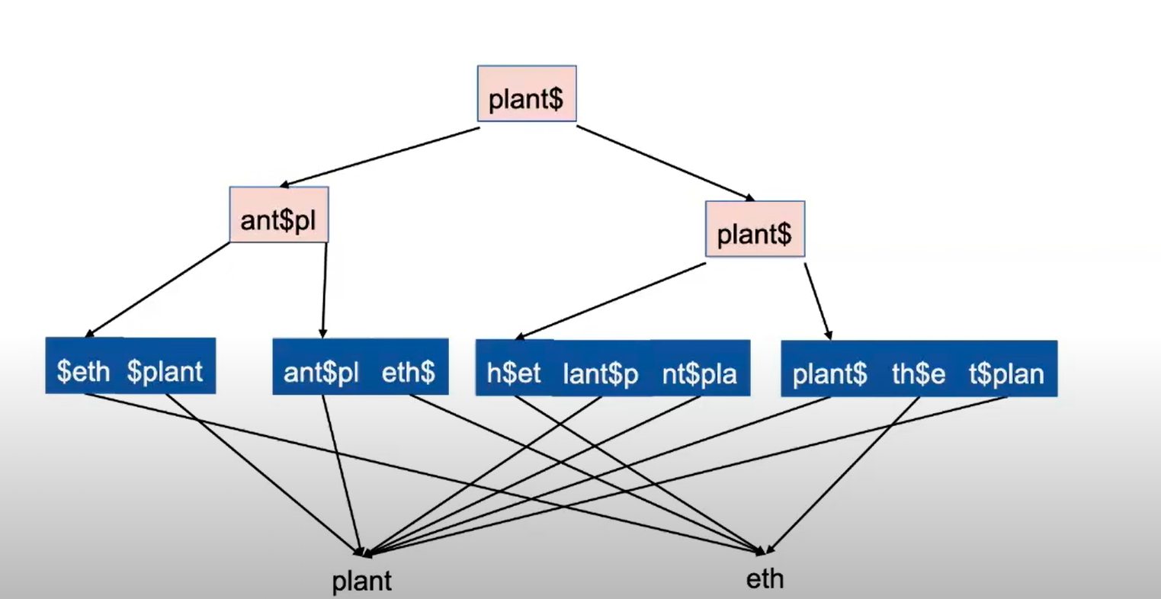

Slide 13

K-Gram
A sequence of k characters
Example: castle has 3 grams as , cas, ast, tle
In a k-gram index, the dictionary contains all k-grams that occur in any term in the vocabulary
Maantain an n gram inverted index
Example:
Wildcard Query= Re*ve
$re, ve$
Post Filtering:
Computer, 1-gram, 2-gram,…

Slide 14
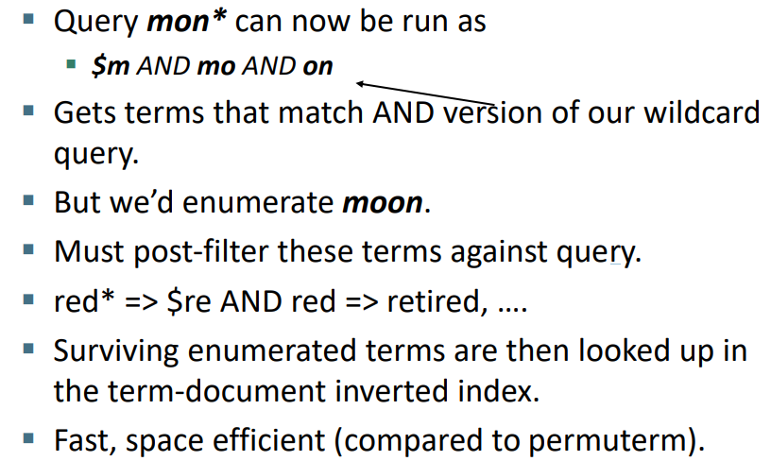
Processing Wildcard Query
Execute query as Boolean query for each enumerated , filtered term: disadvantages ?

Slide 15
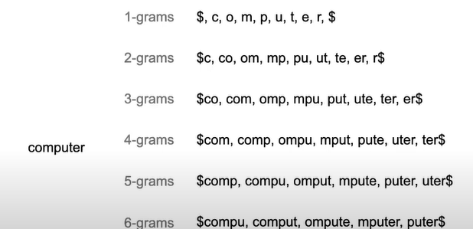
K-gram
Which k is useful and why ?

Slide 16
Task
Give 3-gram index vocabulary for the terms ‘index’ and ‘independent’?

Slide 17
